Slide 1
The Calculation of the Potential of Mean Force
Using Computer Simulations
Benoit Roux, Computer Physics Communications, vol. 91, pp. 275-282, 1995.
Presenter : Hsiao-Yen Chang
Date : November 30, 2007

Slide 2
Abstract
The problem of unbiasing and combining the results of
umbrella sampling calculations is reviewed. The weighted
histogram analysis method (WHAM) is described and
compared with other approaches. The method is illustrated
with molecular dynamics simulations of the alanine
dipeptide for one- and two-dimensional free energy
surfaces. The results show that the WHAM approach
simplifies considerably the task of recombining the various
windows in complex systems.

Slide 3
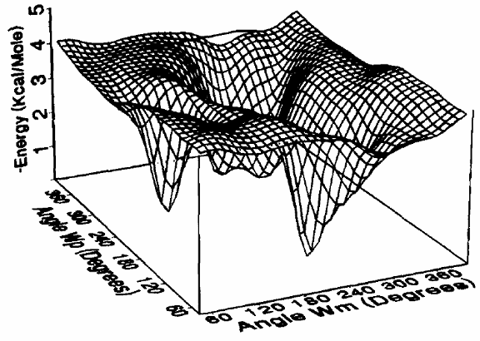
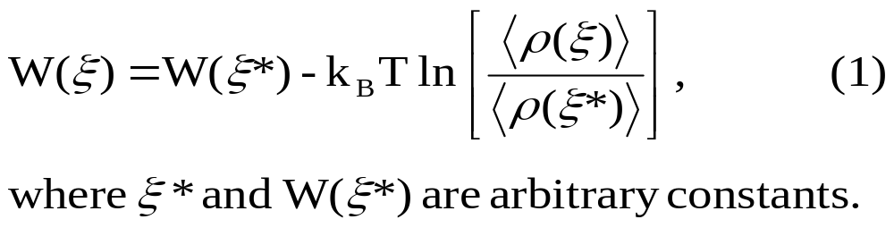
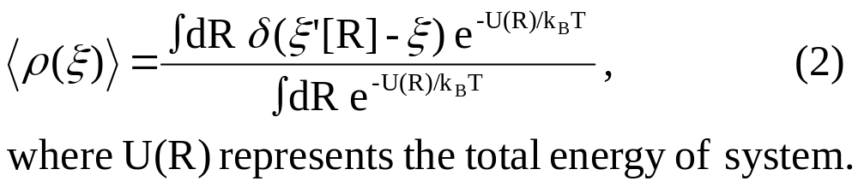
Introduction
The potential of mean force (PMF) W(ξ)
The average distribution function 〈ρ(ξ)〉 along the coordinate ξ is obtained from a Boltzmann weighted average,

Slide 4
Introduction (cont.)
The microscopic system of interest is simulated in the presence of an artificial biasing window potential w(ξ) , introduced to enhance the sampling in the neighborhood of a chosen value ξ.
The biased simulations are generated using the potential energy [U(R) + w(ξ) ] .
w(ξ) = ½K(ξ-ξ_{i})²
The approach is to compute the free energy difference △F_{i,j} = [ F_{i} – F_{j} ] between the adjacent windows.

Slide 5
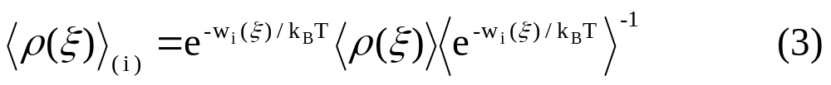
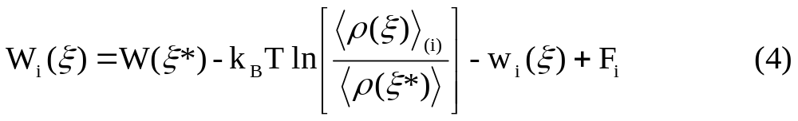
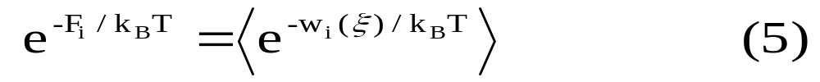
Introduction (cont.)
The biased distribution function obtained from the ith biased ensemble is
The unbiased PMF from the ith window is
where the undetermined constant F_{i} defined from

Slide 6
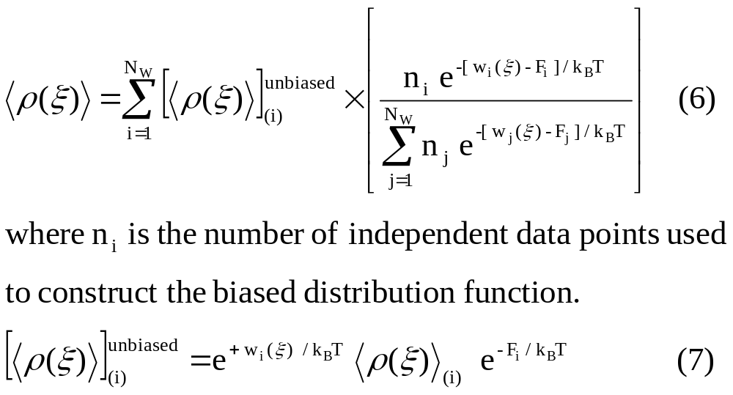
The weighted histogram analysis method (WHAM)
The WHAM equations express the optimal estimate for the unbiased distribution function as a ξ-dependent weighted sum over the N_{w} individual unbiased distribution functions

Slide 7
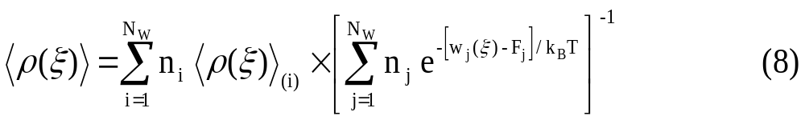
The weighted histogram analysis method (WHAM) (cont.)
The biased distribution function is
The free energy constants F_{i} is

Slide 8
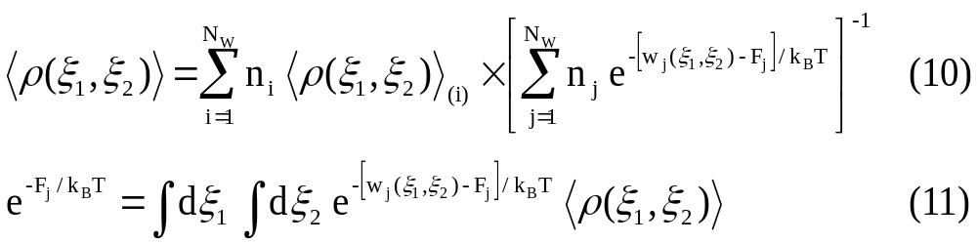
The weighted histogram analysis method (WHAM) (cont.)
Extensions of the method to multidimensional cases is straightforward. For example, in the case of two variables ξ_{l} and ξ₂ …

Slide 9
The free energy perturbation method (FEP)
The method is to calculate the free energy difference ΔF_{i,i-1} between the window potentials w_{i} and w_{i-1} ,
In one dimension, the constants F_{i} can be obtained by recurrence,

Slide 10
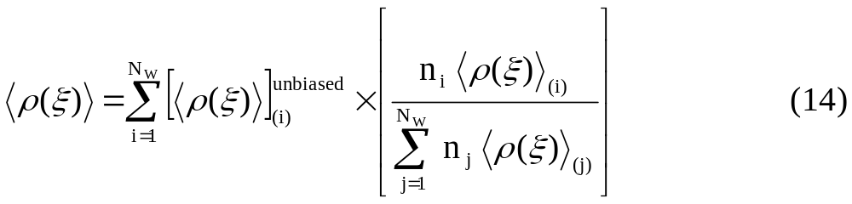
The weighted distribution function (W-DF)
The method used a weighted sum over the individual unbiased distribution functions extracted the N_{w} windows,

Slide 11
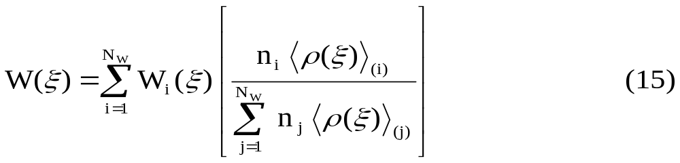
The weighted potential of mean force (W-PMF)
The method used a weighted sum over the individual unbiased PMF's W_{i}(ξ) ,

Slide 12
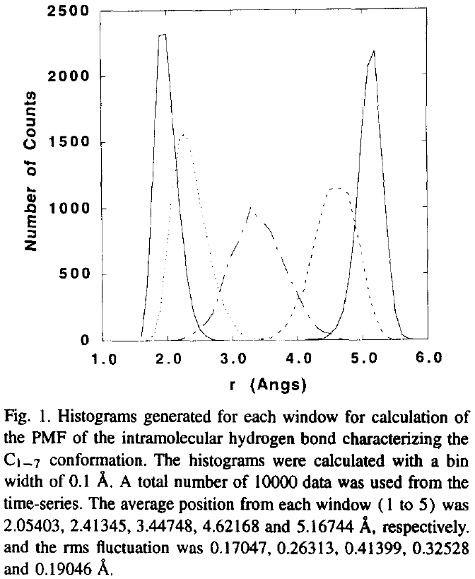
w_{i}(r) = ½ K ( r - r_{i} )²
  K = 5 kcal / (mol Å²)
The self-consistent set of
equations (WHAM, W-PMF and
W-DF) were iterated until
changes in the free energy
constants F_{i} were less than
0.001 kcal/mol.
w_{i}(r, d) = ½K_{r}(r-r_{i})² + ½K_{d}(d-d_{i})²
  K_{r} = K_{d} = 10 kcal / (mol Å²)
An eight by eight grid of
windows along r and d,
centered on 1.0, 1.5, 2.0 ...
5.5Å.

Slide 13
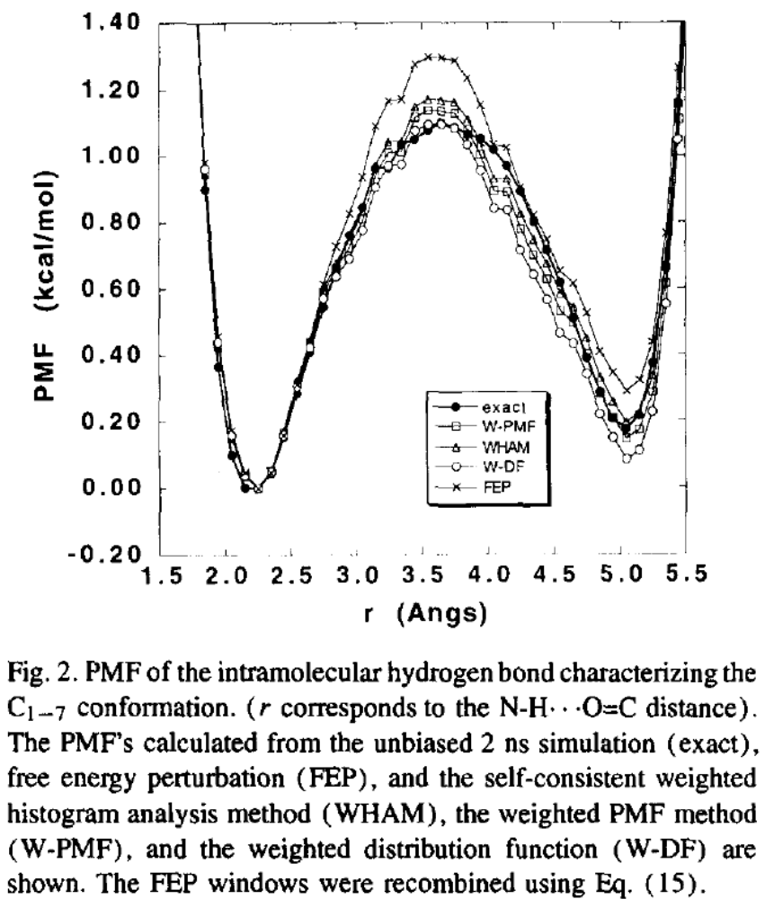
Results
All the calculations were done including all hydrogen atoms with the CHARMM PARM22 potential function for the peptides and TIP3P for the water.

Slide 14
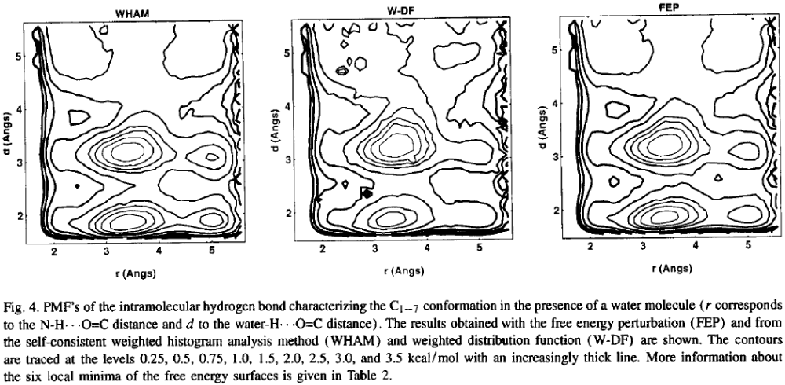
Results

Slide 15
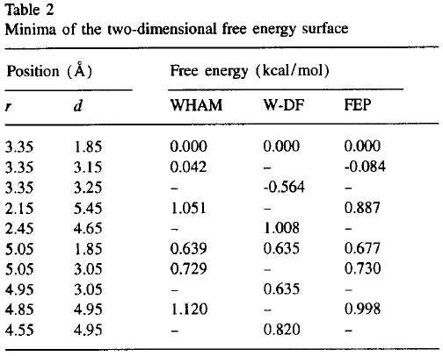
Results

